Slide 1
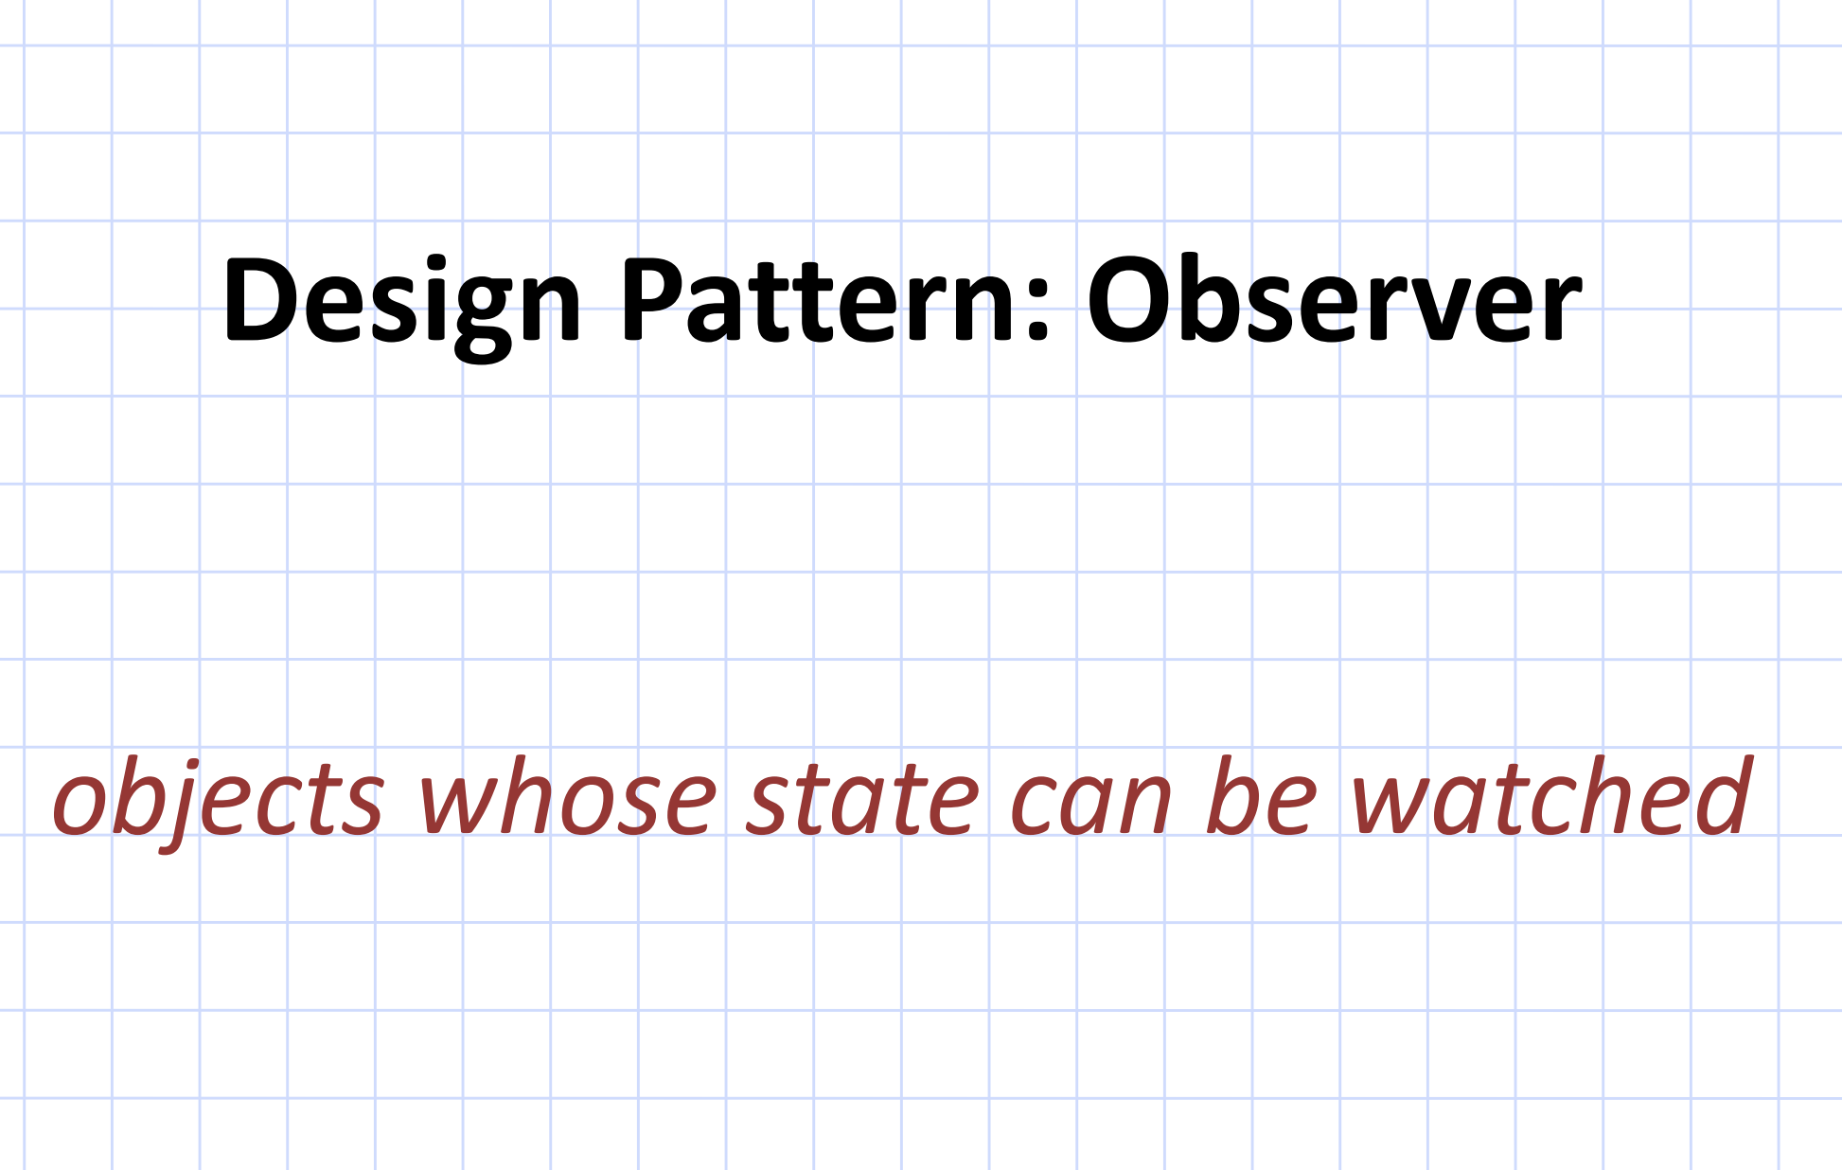

Slide 2
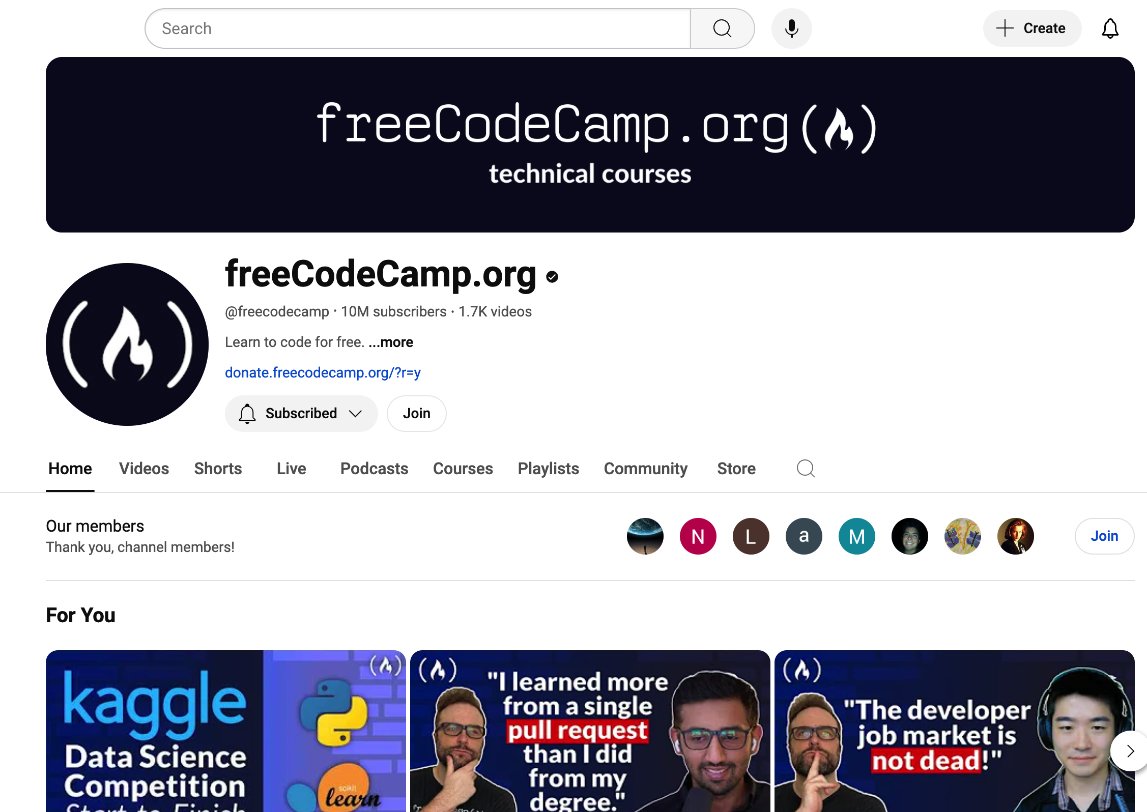
Observer Design Pattern

Slide 3


Channel
Subscribers

Slide 4

Observer Design Pattern
Channel
Subscribers

Slide 5
Observer Design Pattern
Observers
Channel
Subject
1-to-many
Subscribers
Notes:
The Observer Design Pattern is a behavioral design pattern that defines a one-to-many relationship between objects. In this pattern, when one object changes its state (called the subject), all the other objects (called observers) that are dependent on the subject are notified and automatically updated. without tightly coupling them.

Slide 6


Slide 7
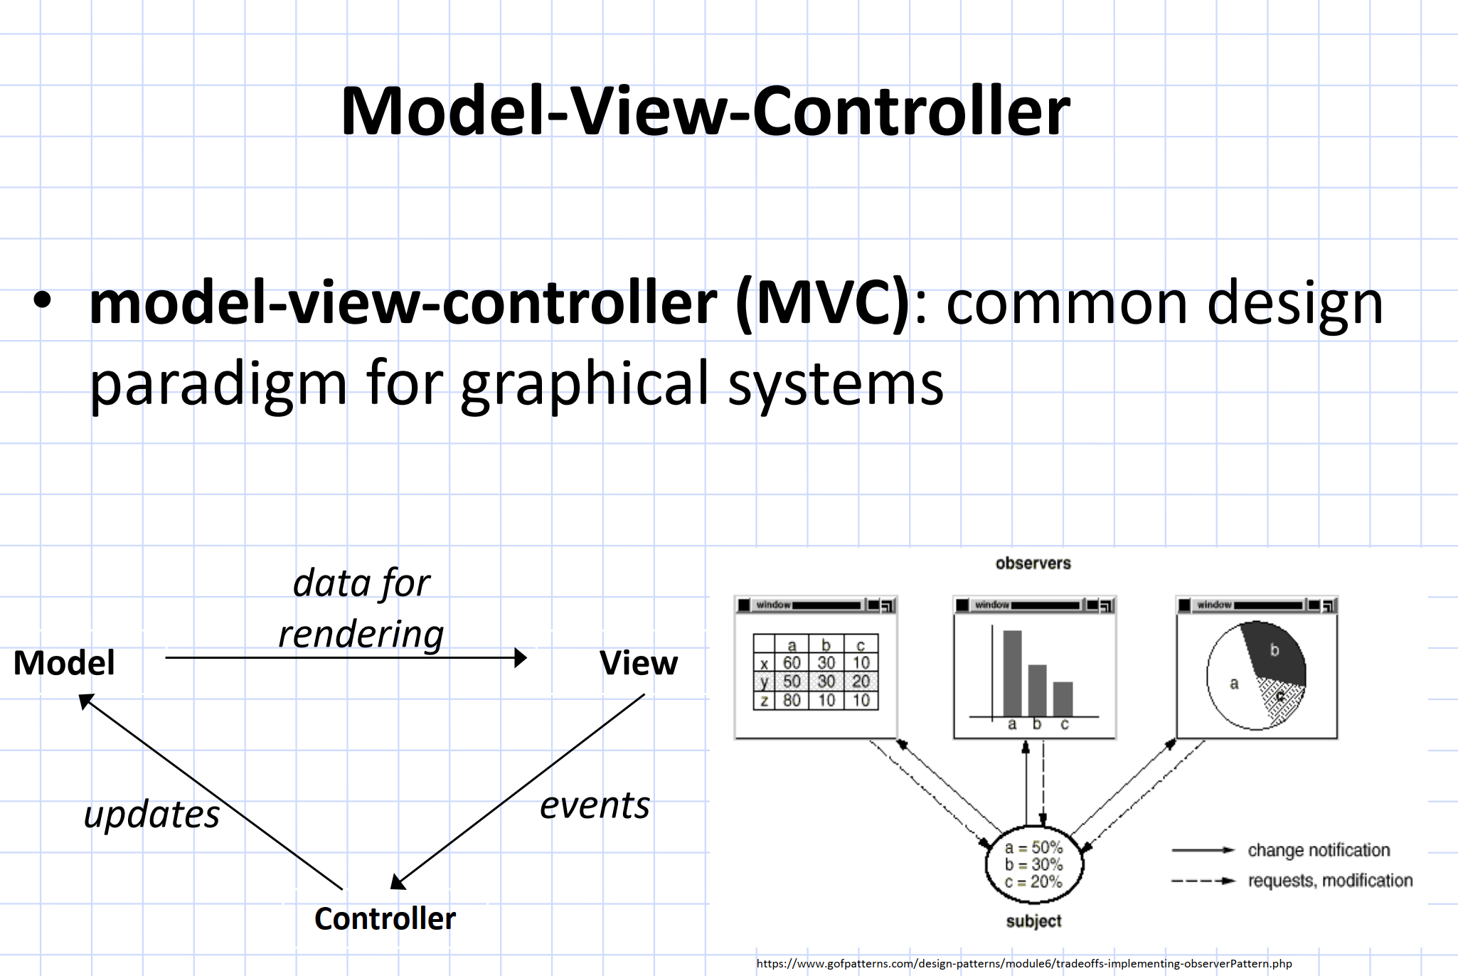

Slide 10
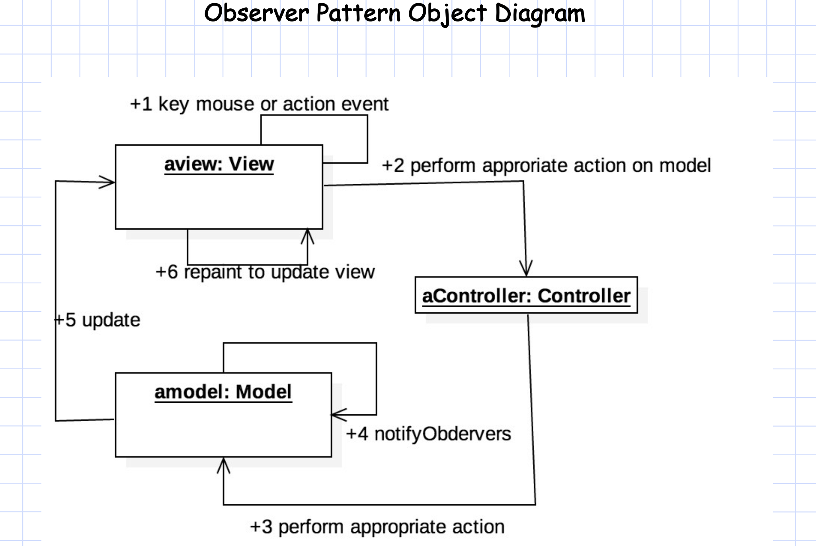

Slide 11
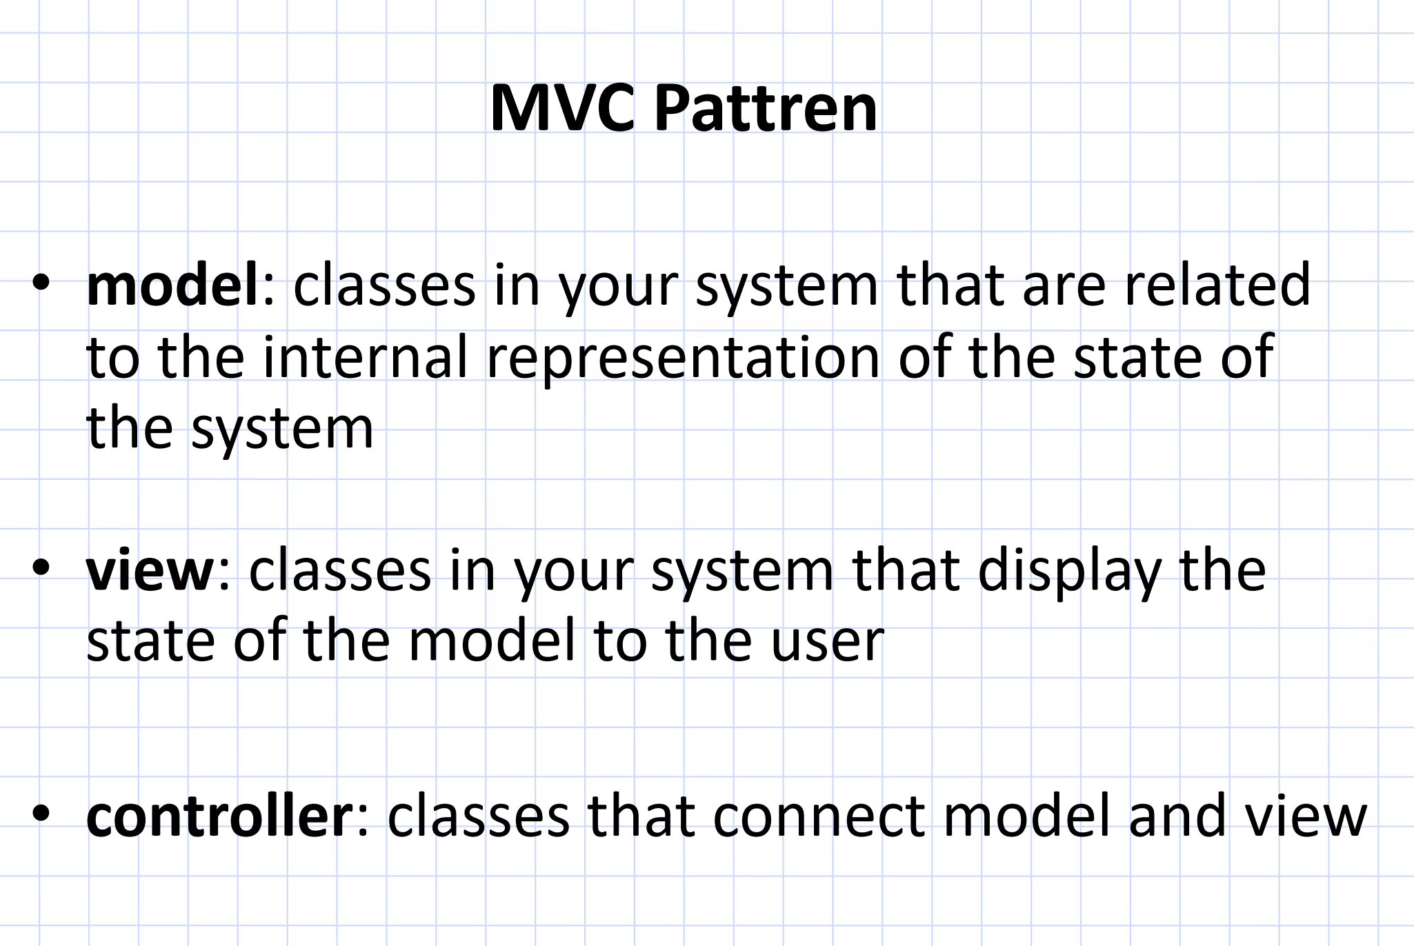

Slide 12
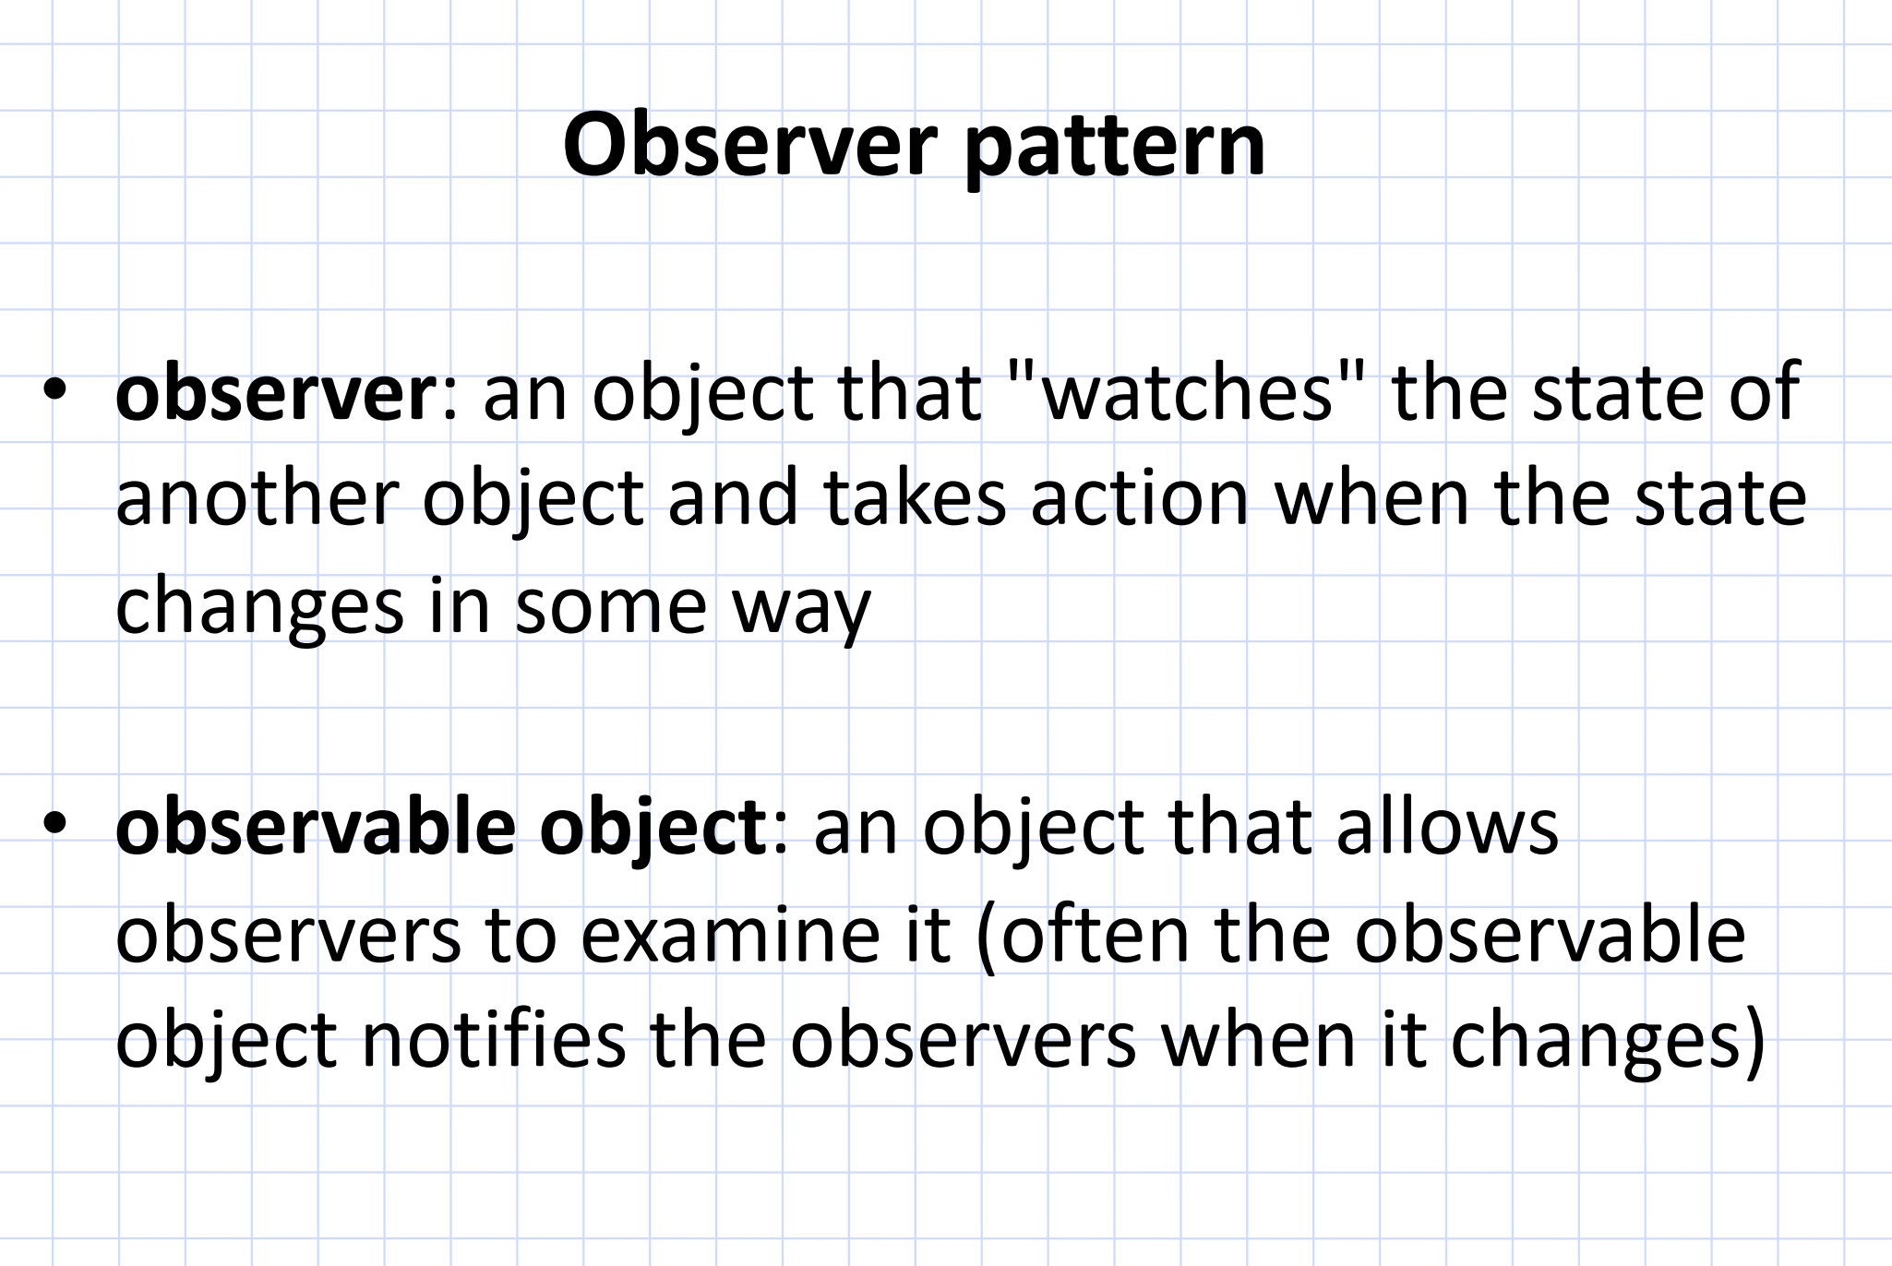

Slide 13
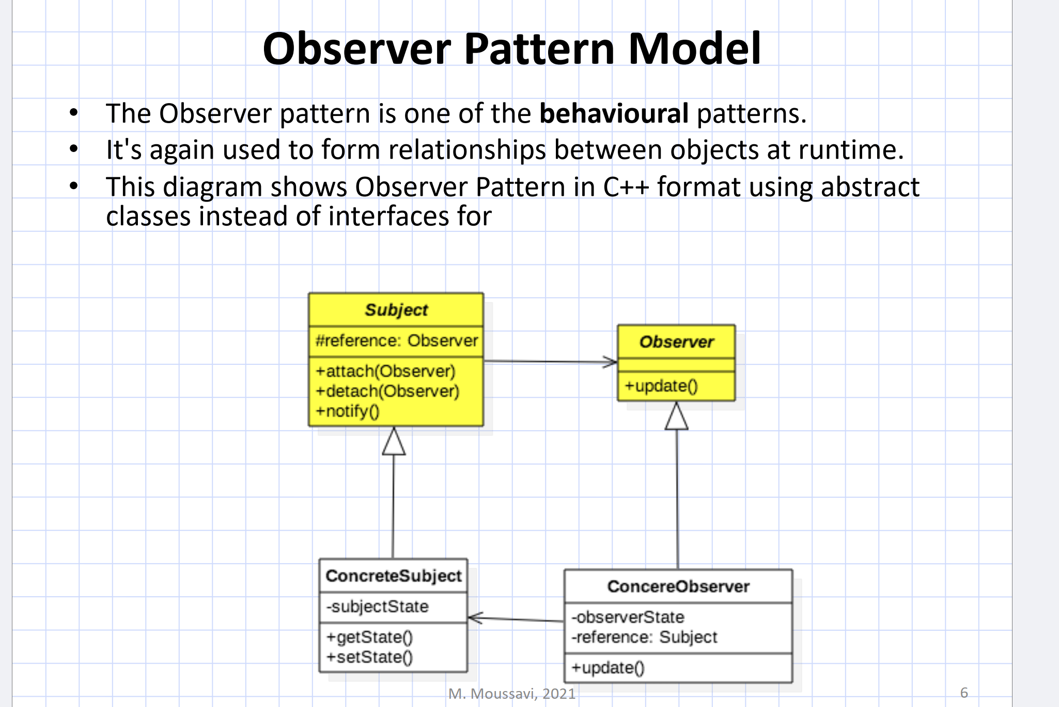
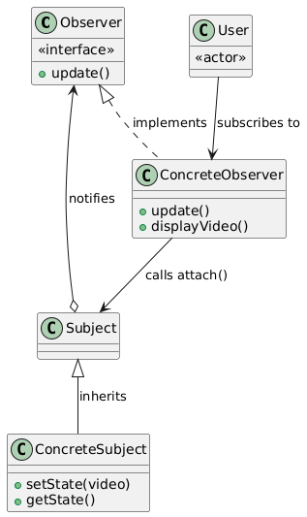

Slide 14
How the Observer Pattern Works
Observers Register with Subject
Subject’s State Changes
Subject Notifies All Observers
Observers React to the Notification

Slide 15
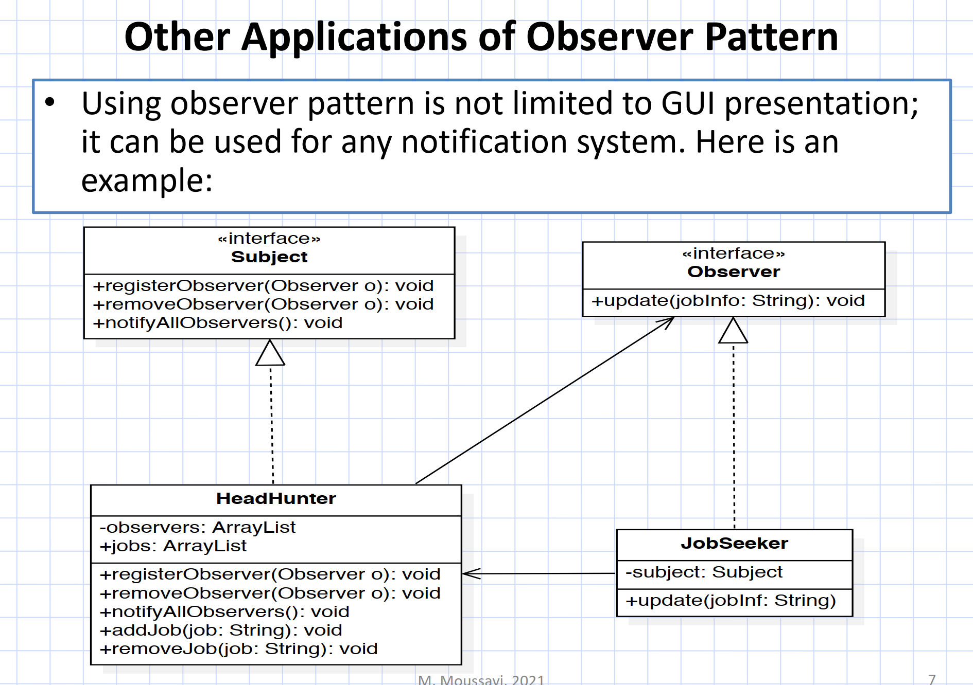

Slide 16
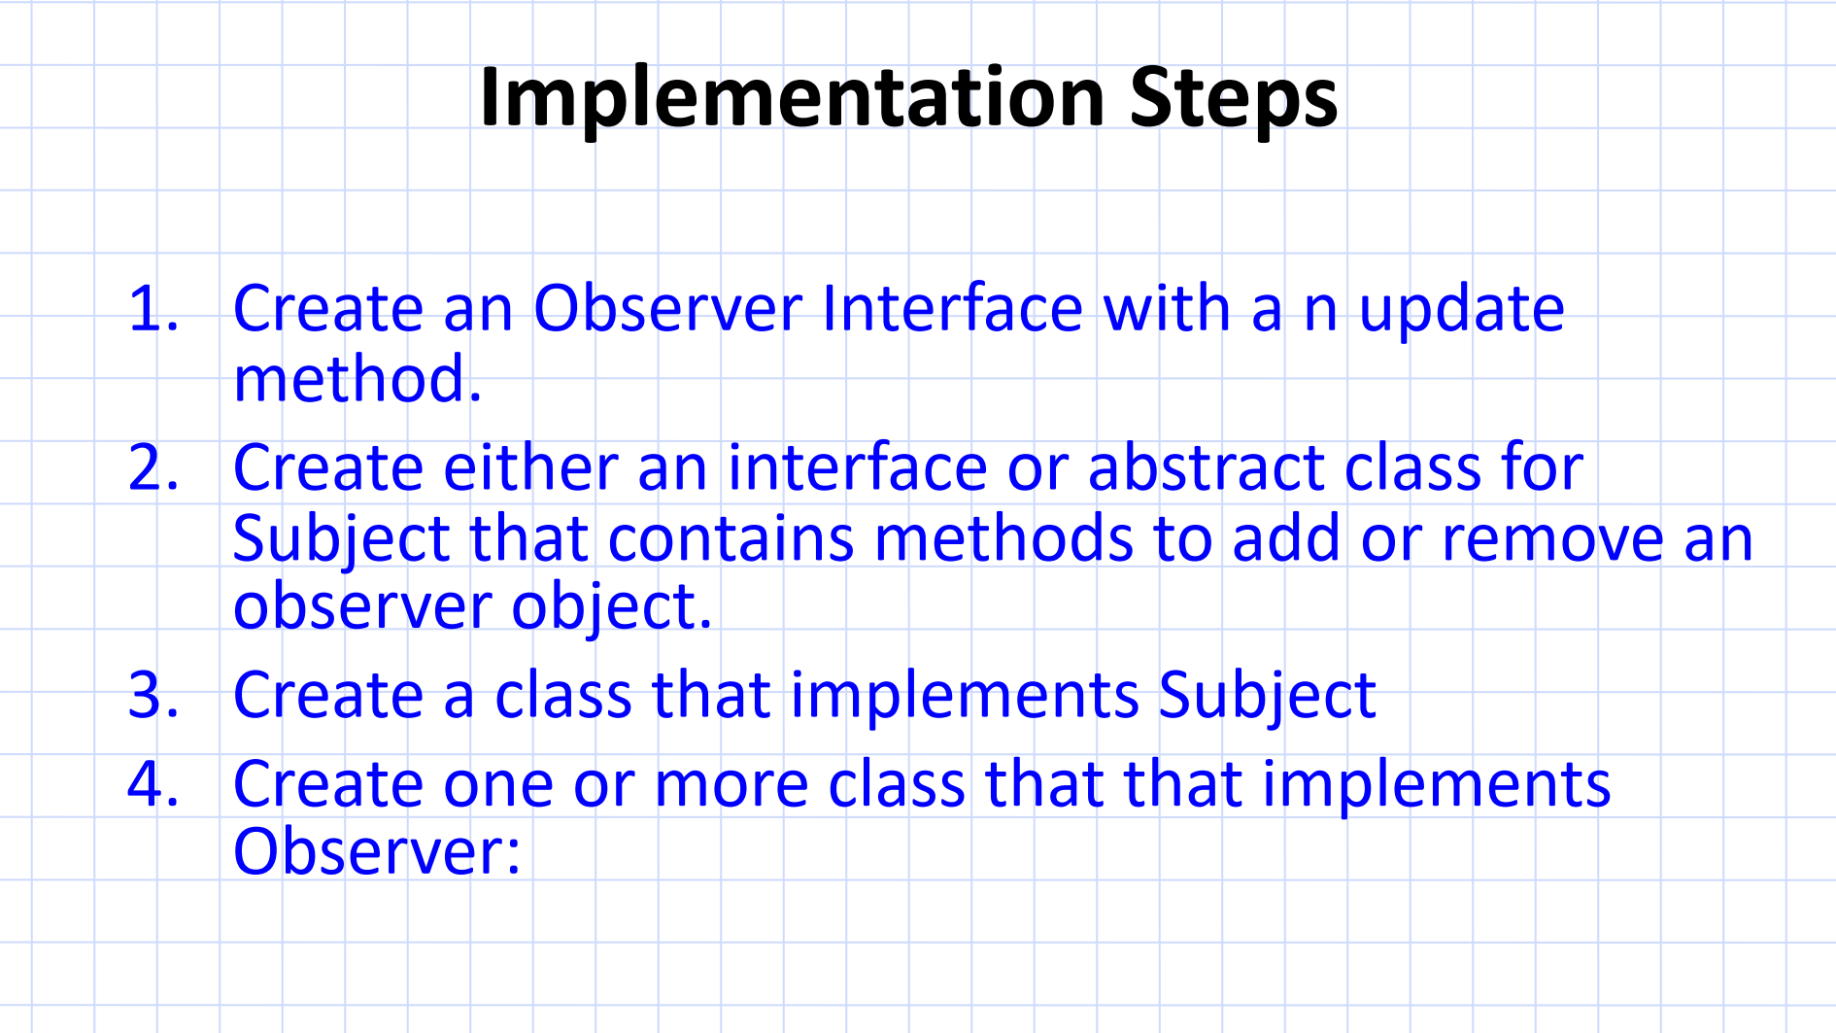

Slide 17
Subscriber Interface (Observer)
class Subscriber {
public:
virtual void update(const std::string& videoTitle) = 0; // Observer gets updated
};

Slide 18
Concrete Subscriber
class ConcreteSubscriber : public Subscriber {
private:
std::string name;
public:
ConcreteSubscriber(const std::string& subscriberName) : name(subscriberName) {}
void update(const std::string& videoTitle) override {
std::cout << name << " received notification: " << videoTitle << std::endl;
}
};

Slide 19
YouTubeChannel (Subject)
class YouTubeChannel {
private:
std::vector<Subscriber*> subscribers; // List of observers
std::string latestVideo;
public:
void uploadVideo(const std::string& videoTitle) {
latestVideo = videoTitle;
notifySubscribers(); // Notify observers (subscribers)
}
void addSubscriber(Subscriber* subscriber) {
subscribers.push_back(subscriber);
}
void notifySubscribers() {
for (Subscriber* subscriber : subscribers) {
subscriber->update(latestVideo); // Notify all observers
}
}
};

Slide 20
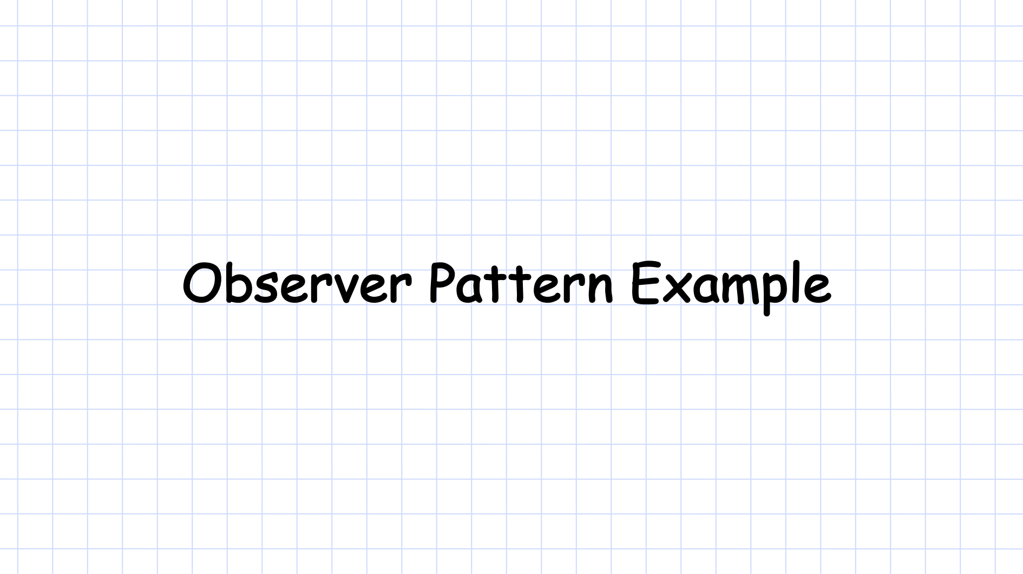

Slide 21
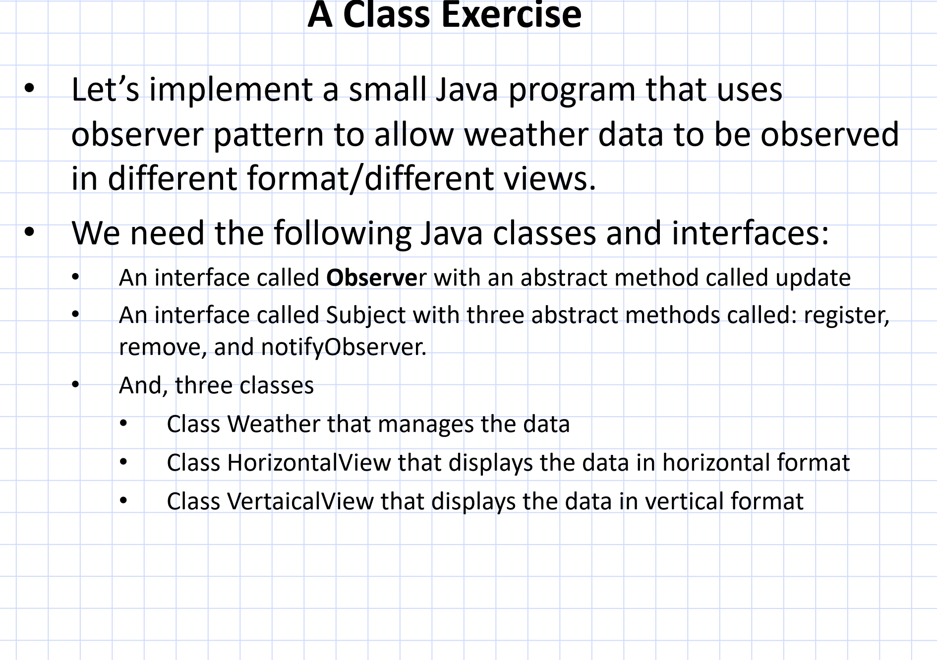

Slide 22
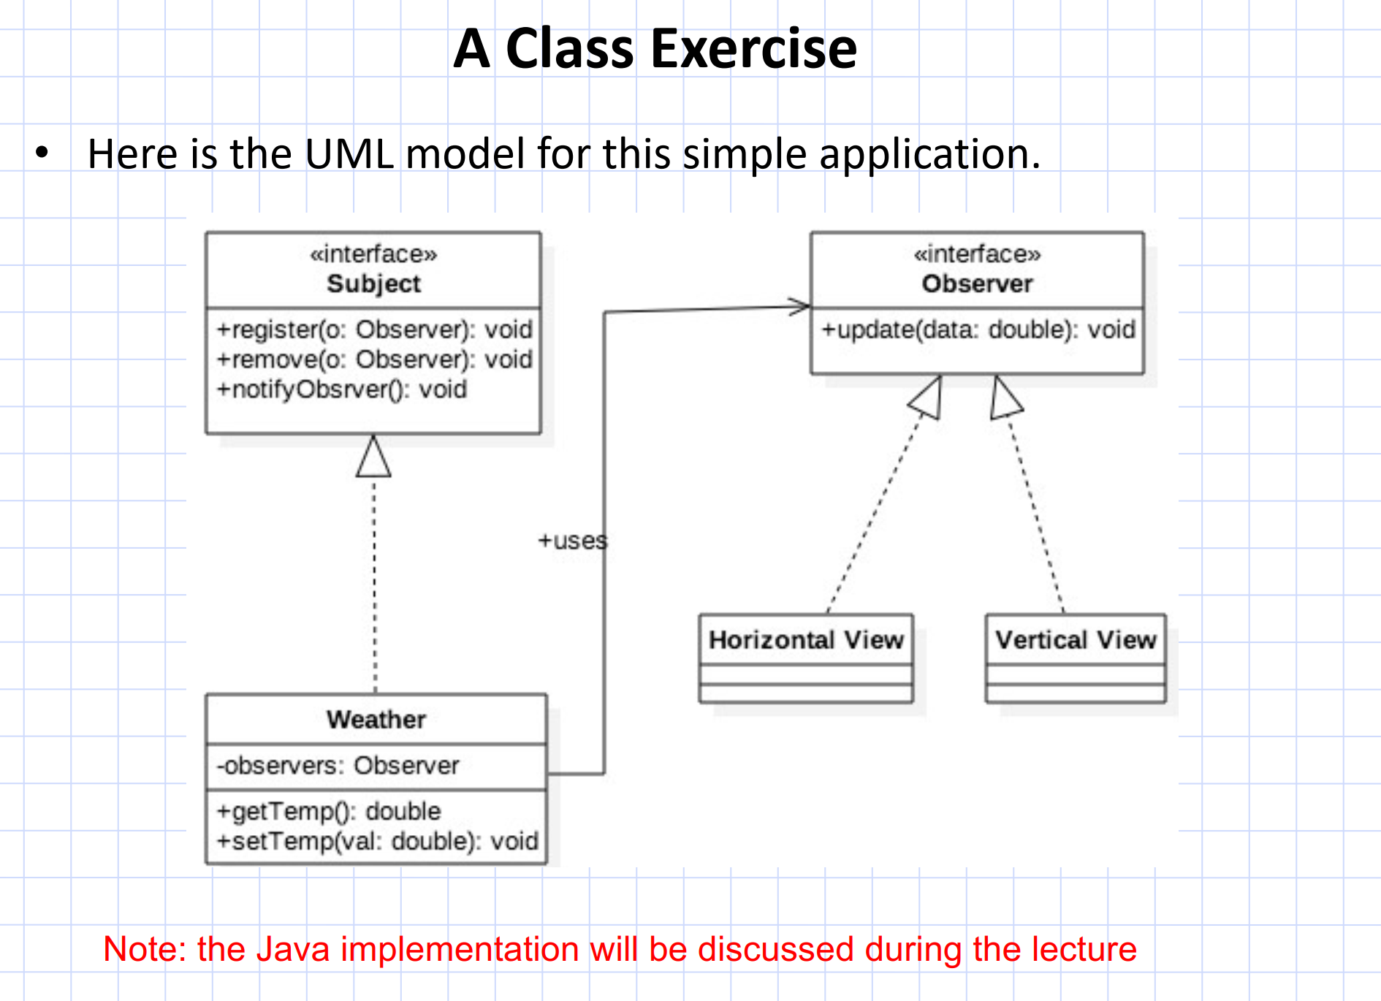

Slide 23
Java implementation
Observer Interface
Subject Interface
public interface Observer {
void update(double temperature); // Observers will update based on temperature
}
public interface Subject {
void registerObserver(Observer o); // Add an observer
void removeObserver(Observer o); // Remove an observer
void notifyObservers(); // Notify all observers of state change
}

Slide 24
Java implementation
Weather Class (ConcreteSubject)
// Remove an observer
@Override
public void removeObserver(Observer o) {
observers.remove(o);
}
// Notify all registered observers of temperature change
@Override
public void notifyObservers() {
for (Observer observer : observers) {
observer.update(temperature);
}
}
// Set new temperature and notify observers
public void setTemperature(double temperature) {
this.temperature = temperature;
notifyObservers(); // Notify all observers about the change
}
}
import java.util.ArrayList;
import java.util.List;
public class Weather implements Subject {
private List<Observer> observers; // List to hold all observers
private double temperature;
public Weather() {
observers = new ArrayList<>();
}
// Register an observer
@Override
public void registerObserver(Observer o) {
observers.add(o);
}

Slide 25
Java implementation
HorizontalView Class (ConcreteObserver)
public class HorizontalView implements Observer {
private double temperature;
// When notified by the subject, update the view
@Override
public void update(double temperature) {
this.temperature = temperature;
display();
}
// Display the temperature in horizontal format
public void display() {
System.out.println("Horizontal View - Temperature: " + temperature);
}
}

Slide 26
Java implementation
public class VerticalView implements Observer {
private double temperature;
// When notified by the subject, update the view
@Override
public void update(double temperature) {
this.temperature = temperature;
display();
}
// Display the temperature in vertical format
public void display() {
System.out.println("Vertical View");
System.out.println("Temperature: " + temperature);
}
}

Slide 27
Java implementation
public class WeatherStation {
public static void main(String[] args) {
// Create the weather subject (the source of data)
Weather weather = new Weather();
// Create observers
HorizontalView horizontalView = new HorizontalView();
VerticalView verticalView = new VerticalView();
// Register observers with the weather subject
weather.registerObserver(horizontalView);
weather.registerObserver(verticalView);
// Simulate changes in temperature
weather.setTemperature(25.5);
weather.setTemperature(28.0);
}
}

Slide 28
public class HorizontalView implements Observer {
private double temperature;
// When notified by the subject, update the view
@Override
public void update(double temperature) {
this.temperature = temperature;
display();
}
// Display the temperature in horizontal format
public void display() {
System.out.println("Horizontal View - Temperature: " + temperature);
}
}
import java.util.ArrayList;
import java.util.List;
public class Weather implements Subject {
private List<Observer> observers;
private double temperature;
public Weather() {
observers = new ArrayList<>();
}
// Register an observer
@Override
public void registerObserver(Observer o) {
observers.add(o);
}
// Remove an observer
@Override
public void removeObserver(Observer o) {
observers.remove(o);
}
@Override
public void notifyObservers() {
for (Observer observer : observers) {
observer.update(temperature);
}
}
// Set new temperature and notify observers
public void setTemperature(double temperature) {
this.temperature = temperature;
notifyObservers();
}
}
public interface Observer {
void update(double temperature);}
public interface Subject {
void registerObserver(Observer o);
void removeObserver(Observer o);
void notifyObservers();
}
public class WeatherStation {
public static void main(String[] args) {
Weather weather = new Weather();
HorizontalView horizontalView = new HorizontalView();
VerticalView verticalView = new VerticalView();
// Register observers with the weather subject
weather.registerObserver(horizontalView);
weather.registerObserver(verticalView);
// Simulate changes in temperature
weather.setTemperature(25.5);
weather.setTemperature(28.0);
}
}
public class VerticalView implements Observer {
private double temperature;
// When notified by the subject, update the view
@Override
public void update(double temperature) {
this.temperature = temperature;
display();
}
// Display the temperature in vertical format
public void display() {
System.out.println("Vertical View");
System.out.println("Temperature: " + temperature);
}
}

Slide 29
